Slide 1




Restaurant Ranking application
Aazaz ul Haq
Zubair sageer
Concept
Video Presentation
Maham Johnson
Hamza Javed

Slide 2
Restaurant Ranking application
Value Proposition
Problem:-People face difficulty while searching for local food courts. Sometime people are not able to find good and low cost food.
Solution:- We are making a platform to solve such problems where people will be able to find all type of local and branded food and they will be able to order and rank.

Slide 3
SIMPLE TASK
There is no such a platform which help people to Find all nearby Local Restaurant.

Slide 4
MODERATE TASK
People can find and Order food at any time

Slide 5
COMPLEX TASK
People can also rank restaurant according to their services

Slide 6
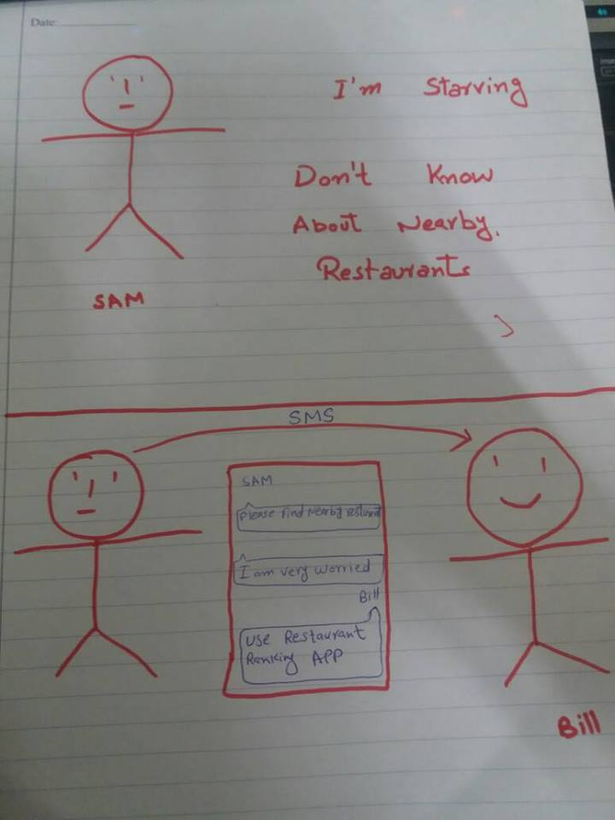
STORYBOARD

Slide 7
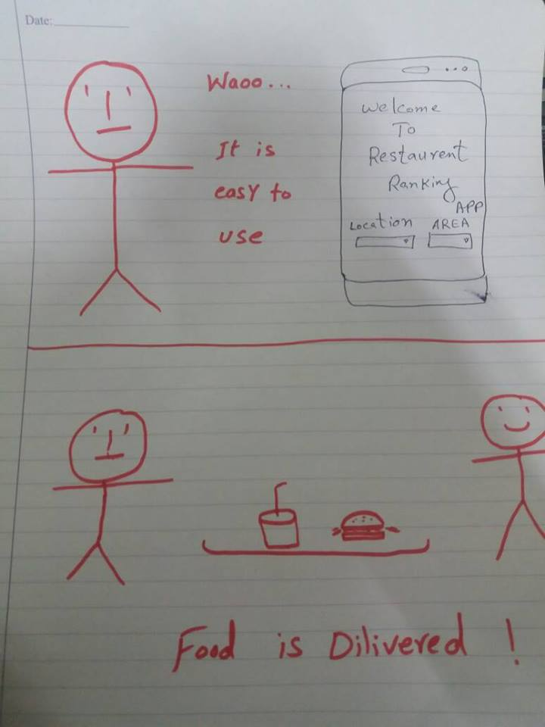
STORYBOARD

Slide 8
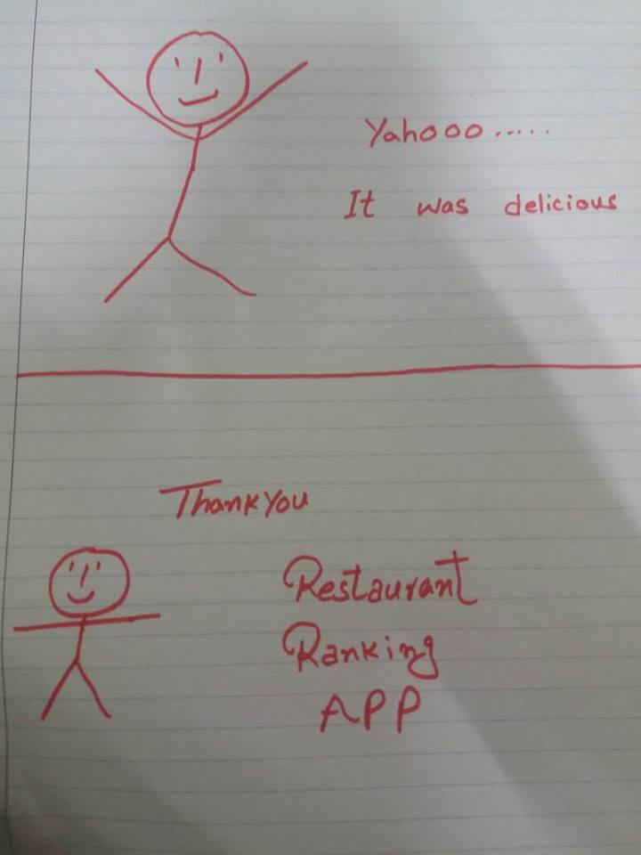
STORYBOARD

Slide 9
https://www.youtube.com/watch?v=kfuEhLaAC0I

